Slide 1
Web Design with HTML and CSS
Day 1

Slide 2
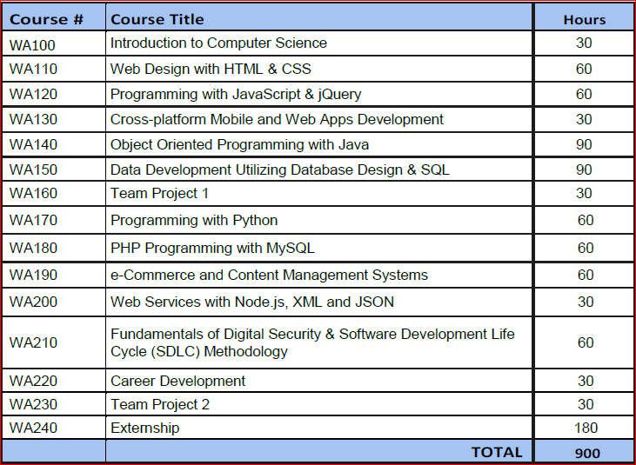

Web Application Design and Development Program Overview

Slide 3
Exploring the Internet
The Internet is a worldwide collection of computers linked together for use by organizations, and individuals using communications devices and media
A node is any device, such as a computer, tablet, or smartphone, connected to a network
A network is a collection of two or more computers linked together to share resources and information
The Internet of Things describes the ever-growing number of devices connecting to a network, including televisions and appliances

Slide 4
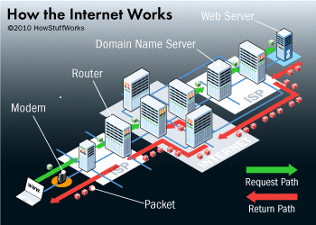
Exploring the Internet
Data lines that connect networks allow data to move from one computer to another
The Internet backbone is a collection of high-speed data lines that connect major computer systems located around the world
An Internet Service Provider (ISP) is a company that has a permanent connection to the Internet backbone
Howstuffworks.com

Slide 5
World Wide Web
The World Wide Web, also called the web, is the service that provides access to information stored on web servers
The web consists of a collection of linked files known as webpages
A website is a related collection of webpages created and maintained by a person, company, educational institution, or other organization
A home page is the first document users see when they access a website
A hyperlink, commonly called a link, is an element that connects one webpage to another webpage on the same server or to any other web server in the world

Slide 6
Protocols
A protocol is a set of rules that defines how a client workstation can communicate with a server
Servers are special computers connected to the Internet. Web pages are files on the server's hard drive. Computers that you have in class are not servers, they are clients, connected to the Internet through ISP.
Hypertext Transfer Protocol (HTTP) is a set of rules for exchanging text, graphics, audio, video, and other multimedia files on the web
File Transfer Protocol (FTP) is used to exchange files from one computer to another over the Internet
This protocol does not provide a way to view a webpage
Transmission Control Protocol/Internet Protocol (TCP/IP) is a pair of protocols used to transfer data efficiently over the Internet by properly routing it to its destination
Internet Protocol (IP) ensures data is sent to the correct location
The Domain Name System (DNS) associates an IP address with a domain name

Slide 7
Web Browsers
A web browser is a program that interprets and displays Web pages and enables you to view and interact with a Web page
Microsoft Internet Explorer, Mozilla Firefox, Google Chrome and Apple Safari are examples of web browsers.
A Uniform Resource Locator (URL) is the address of a document or other file accessible on the Internet, for example
http://www.hunterbusinessschool.edu/calendar-of-events/index.php
A domain is an area of the Internet a particular organization or person manages.

Slide 8
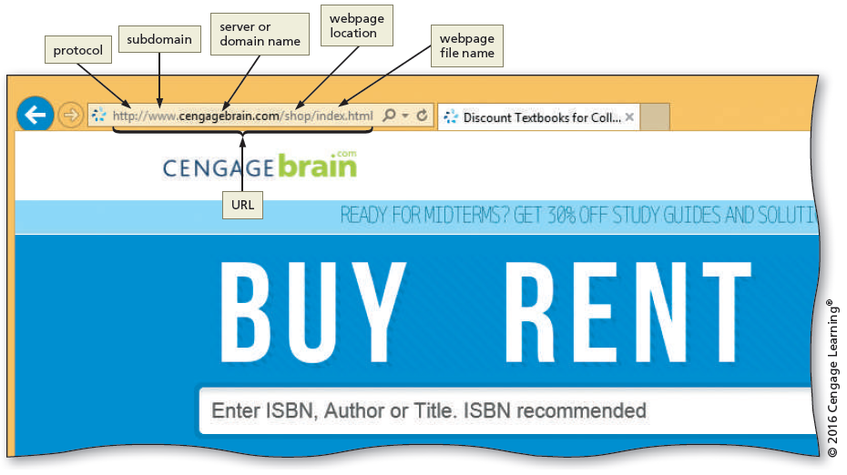
Web Browsers
Notes:
This figure explains the URL in a browser’s address bar.
The first part of the URL reads “http://”. A rectangular box labeled “protocol” is positioned above the URL. An arrow originating from the first rectangular box points to the first part of the URL.
The second part of the URL reads ”www”. A rectangular box labeled “subdomain” is positioned above the URL. An arrow originating from the second rectangular box points to the second part of the URL.
The third part of the URL reads “cengagebrain.com”. A rectangular box labeled “server or domain name” is positioned above the URL. An arrow originating from the third rectangular box points to the third part of the URL.
The fourth part of the URL reads “/shop”. A rectangular box labeled “webpage location” is positioned above the URL. An arrow originating from the fourth rectangular box points to the fourth part of the URL.
The fifth part of the URL reads “/index.html”. A rectangular box labeled “webpage file name” is positioned above the URL. An arrow originating from the fifth rectangular box points to the fifth part of the URL.
The URL “http:// www. cengagebrain.com/shop/index.html” is entered in the address bar. A rectangular box labeled “URL” is positioned below the address bar. An arrow originating from the sixth rectangular box points to the URL in the address bar.

Slide 9
Types of Websites
An Internet site is another term for a website that is generally available to anyone with an Internet connection
An Intranet is a private network that uses Internet technologies to share company information among employees
An Extranet is a private network that uses Internet technologies to share business information with select corporate partners or key customers

Slide 10
Types of Websites
Many company websites also support electronic commerce (e-commerce), which is the buying and selling of goods and services on the Internet
Educational institutions use a Learning Management System (LMS) to simplify course management
An LMS is a web-based software application designed to facilitate online learning

Slide 11
Planning a Website
Purpose of the website — The purpose of a commercial business website is related to the goal of selling products or services
Target Audience — The people who use the website are known as the target audience
Knowing their general demographic background will help to design a website appropriate for them
Multiplatform Display —A responsive design of a website must be created that provides an optimal viewing experience across a range of devices

Slide 12
Wireframe
A wireframe is a simple, visual guide that clearly identifies the location of main webpage elements
Active white space is an area on the page that is intentionally left blank
Passive white space is the space between content areas
Helps a user focus on one part of the page

Slide 13
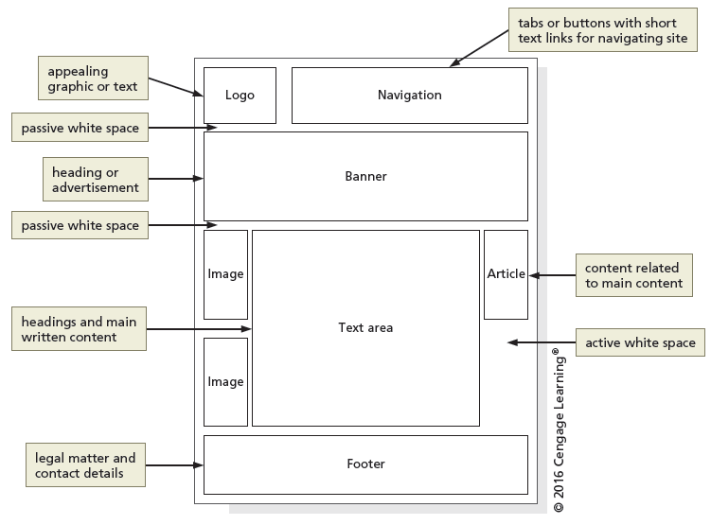
Wireframe
Notes:
The image describes a wireframe sketch for webpages, using lines and boxes.
The first layer of the wireframe consists of a square box and a horizontal rectangular box. The first square box reads “Logo”. A rectangular box labeled “appealing graphic or text” is positioned to the left of the square box. An arrow originating from the rectangular box points to the square box. The horizontal rectangular box reads “Navigation”. A second rectangular box labeled “tabs or buttons with short text links for navigating site” is positioned to the right of the horizontal rectangular box. An arrow originating from the second rectangular box points to the horizontal rectangular box.
The image shows space between the first and the second layers of the wireframe. A rectangular box labeled “passive white space” is positioned to the left of the space in the image. An arrow originating from the third rectangular box points to the space.
The second layer of the image consists of a second horizontal rectangular box. A rectangular box labeled “heading or advertisement” is positioned to the left of the second horizontal rectangular box. An arrow originating from the fourth rectangular box points to the second horizontal rectangular box.
The image shows space between the second and the third layers of the wireframe. A rectangular box labeled “passive white space” is positioned to the left of the space in the image. An arrow originating from the fifth rectangular box points to the space.
The third layer of the image consists of a three vertically elongated rectangular boxes and one big square box. Two of the vertically elongated rectangular boxes are placed top and bottom to the left of the big square box. They read “Image”. The big square text box reads “Text area”. A rectangular box labeled “headings and main written content” is positioned to the left of the space in the image. An arrow originating from the sixth rectangular box points to the big square box in the center. The third vertically elongated rectangular box to the top right of the big square box read “Article”. A rectangular box labeled ”content related to main content” is positioned to the right of the third vertically elongated rectangular box. An arrow originating from the seventh rectangular box points to the vertically elongated rectangular box labeled “Article”. There is blank space below the third vertically elongated rectangular box. A rectangular box labeled “active white space” is positioned to the right of the image. An arrow originating from the eighth rectangular box points to the blank space below the box labeled “Article”.
The fourth layer of the wireframe consists of a horizontal rectangular box. A horizontal rectangular box reads “Footer”. A rectangular box labeled “legal matter and contact details” is positioned to the left of the horizontal rectangular box. An arrow originating from the ninth rectangular box points to the horizontal rectangular box.

Slide 14
Site Map
A site map is a planning tool that lists or displays all the pages on a website and indicates how they are related to each other
It shows the structure of a website

Slide 15
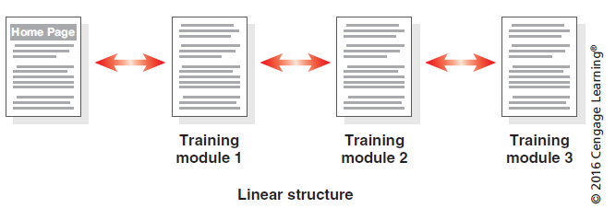
Site Map
A linear website structure connects webpages in a straight line
Notes:
The image explains a linear structured webpage.
The first rectangular box reads “Home Page”.
A second rectangular box to the right of the first rectangular box is labeled “Training module 1”. A bi-directional arrow is positioned between the first rectangular box and the second rectangular box.
A third rectangular box to the right of the second rectangular box is labeled “Training module 2”. A bi-directional arrow is positioned between the second rectangular box and the third rectangular box.
A fourth rectangular box to the right of the third rectangular box is labeled “Training module 3”. A bi-directional arrow is positioned between the third rectangular box and the fourth rectangular box.

Slide 16
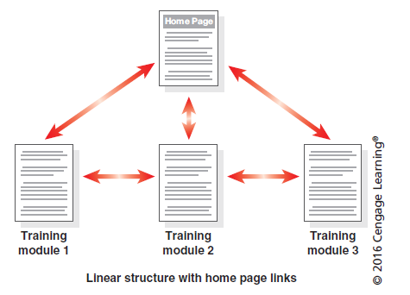
Site Map
In a variation of a linear website structure, each page can include a link to the home page of the website
Notes:
The image explains a webpage that has a linear structure with home page links.
The first line consists of a rectangular box that reads “Home Page”.
The first box in the second line is labeled “Training module 1”. A bi-directional arrow is placed between the first rectangular box in the first line and second rectangular box in the second line.
The second line consists of a rectangular box labeled “Training module 2” positioned to the right of the first rectangular box in the second line. A bi-directional arrow is placed between the first rectangular box and the second rectangular box.
A rectangular box labeled “Training module 3” is positioned to the right of the second rectangular box. A bi-directional arrow is placed between the second rectangular box and the third rectangular box. Another bi-directional arrow is placed between the first rectangular box in the first line and the third rectangular box in the second line.

Slide 17
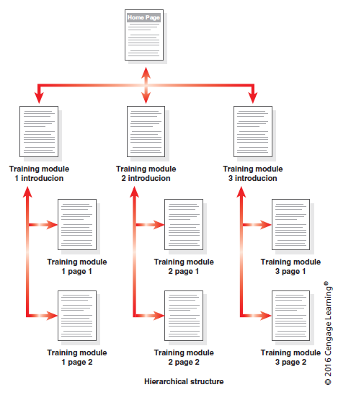
Site Map
A hierarchical website connects webpages in a treelike structure
Notes:
The image describes a hierarchical structure of a webpage.
The first line consists of the first rectangular box that reads “Home Page”.
The second line consists of a second rectangular box that is labeled “Training module 1 introduction”. A third rectangular box to the right of the second rectangular box is labeled “Training module 2 introduction”. A fourth rectangular box to the right of the third rectangular box is labeled “Training module 3 introduction”. A bi-directional arrow originating from the first rectangular box points to the second rectangular box, third rectangular box, and fourth rectangular box.
The third line consists of a fifth rectangular box labeled “Training module 1 page 1”. A bi-directional arrow is positioned between the second and the fifth rectangular boxes. A sixth rectangular box labeled “Training module 2 page 1” is positioned to the right of the fifth rectangular box. A bi-directional arrow is positioned between the third and the sixth rectangular boxes. A seventh rectangular box labeled “Training module 3 page 1” is positioned to the right of the sixth rectangular box. A bi-directional arrow is positioned between the fourth and the seventh rectangular boxes.
The fourth line consists of an eighth rectangular box labeled “Training module 1 page 2” positioned below the fifth rectangular box. A bi-directional arrow is positioned between the second, fifth, and the eighth rectangular boxes. A ninth rectangular box labeled “Training module 2 page 2” is positioned to the right of the eighth rectangular box and below the sixth rectangular box. A bi-directional arrow is positioned between the third, sixth, and the ninth rectangular boxes. A tenth rectangular box labeled “Training module 3 page 2” is positioned to the right of the ninth rectangular box and below the seventh rectangular box. A bi-directional arrow is positioned between the fourth, seventh, and the tenth rectangular boxes.

Slide 18
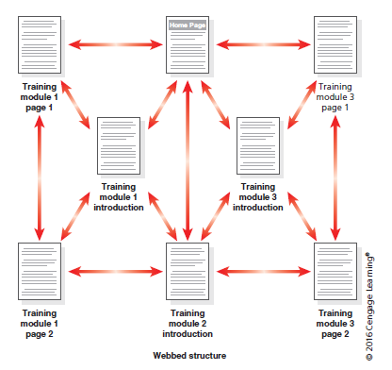
Site Map
A webbed website structure has no set organization
Notes:
The image describes a webpage that has a webbed structure.
The first line consists of a rectangular box that is labeled “Training module 1 page 1”. A second rectangular box positioned to the right of the first rectangular box reads “Home Page”. A bi-directional arrow is positioned between the first and the second rectangular boxes. A third rectangular box positioned to the right of the second rectangular box is labeled “Training module 3 page 1”. A bi-directional arrow is positioned between the second and the third rectangular boxes.
The second line consists of a fourth rectangular box labeled “Training module 1 introduction”. A bi-directional arrow is positioned between the first rectangular, third box second rectangular box. A fifth rectangular box labeled “Training module 3 introduction” is positioned to the right of the fourth rectangular box. A bi-directional arrow is positioned between the second rectangular box and the third rectangular box.
The third line consists of a sixth rectangular box labeled “Training module 1 page 2”. A bi-directional arrow is positioned between the first rectangular box and the fourth rectangular box. A seventh rectangular box labeled “Training module 2 introduction” is positioned to the right of the sixth rectangular box. A bi-directional arrow is positioned between the fourth rectangular box, second rectangular box, fifth rectangular box, and the sixth rectangular box. A rectangular box labelled “Training module 3 page 2” is positioned to the right of the seventh rectangular box. A bi-directional arrow is positioned between the seventh rectangular box, fifth rectangular box, and the third rectangular box.

Slide 19
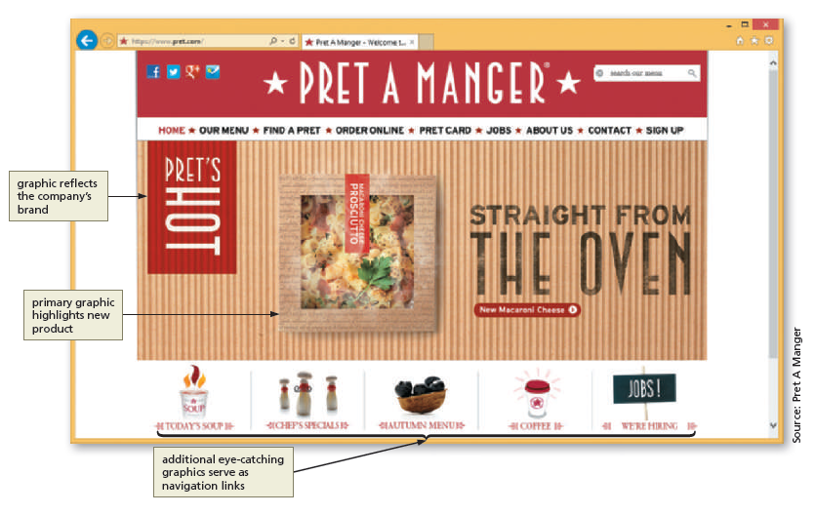
Graphics
Graphics add visual appeal to a webpage and enhance the visitor’s perception of the products and services
Notes:
This figure explains the website for Pret A Manger that displays a new product and which serves as the focal point on the website.
The first rectangular section reads “Pret A Manager”.
The second rectangular section consists of nine sub sections that read “HOME”, “OUR MENU”, “FIND A PRET”, “ORDER ONLINE”, “PRET CARD”, “JOBS”, “ABOUT US”, “CONTACT”, and “SIGN UP”.
The third rectangular section consists of three sub sections. The first vertically rectangular sub section reads “PRET’S HOT”. A rectangular box positioned to the left of the first sub section is labeled “graphic reflects the company’s brand”. The second squared sub section reads “PROSCUITTO”. A second rectangular box positioned to the left of the image is labeled “primary graphic highlights new product”. An arrow originating from the second rectangular box points to the second sub section. The third sub section reads “STRAIGHT FROM THE OVEN”.
The fourth section consists of five sub sections that read “TODAY’S SOUP”, “CHEF’S SPECIAL”, “AUTUMN MENU”, “COFFEE”, and “WE’RE HIRING”. A rectangular box positioned to the bottom-left of the image is labeled “additional eye-catching graphics serve as navigational links”. An arrow originating from the third rectangular box points to the third sub section.

Slide 20
Navigation
The navigation of a website should be clear and concise
Each webpage should have a designated navigation area with links to other pages in the site
The navigation area should be prominent and easy to use

Slide 21
Typography
The use of effective typography, or fonts and font styles, enhances the visual appeal of a website
Typography also should promote the purpose and goal of the website

Slide 22
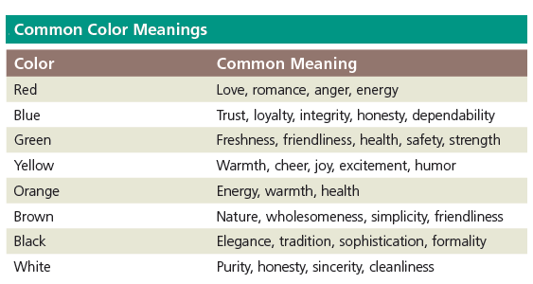
Color
The combination of colors contributes to the appeal and legibility of the website
Aim to strike a balance among the background color, text color, and the color that represents a brand
Colors convey meanings
Notes:
This table has nine rows and two columns. The first cell in the first row of the first column is titled as Color. Following information is given under this column.
Row 2: Red
Row 3: Blue
Row 4: Green
Row 5: Yellow
Row 6: Orange
Row 7: Brown
Row 8: Black
Row 9: White
The second column in the first row is titled as Common Meaning. Following information is given under this column.
Row 2: Love, romance, anger, energy
Row 3: Trust, loyalty, integrity, honesty, dependability
Row 4: Freshness, friendliness, health, safety, strength
Row 5: Warmth, cheer, joy, excitement, humor
Row 6: Energy, warmth, health
Row 7: Nature, wholesomeness, simplicity, friendliness
Row 8: Elegance, tradition, sophistication, formality
Row 9: Purity, honesty, sincerity, cleanliness

Slide 23
Accessibility
A web designer should create pages for viewing by a diverse audience, including people with physical impairments and global users
The World Wide Web Consortium (W3C) develops and maintains web standards, language specifications, and accessibility recommendations.

Slide 24
Planning Checklist
Navigation, typography, color, and accessibility are the basic web page design criteria to consider when developing a website
A sophisticated website requires additional design considerations and research of the business, its competition, and a complete business analysis

Slide 25
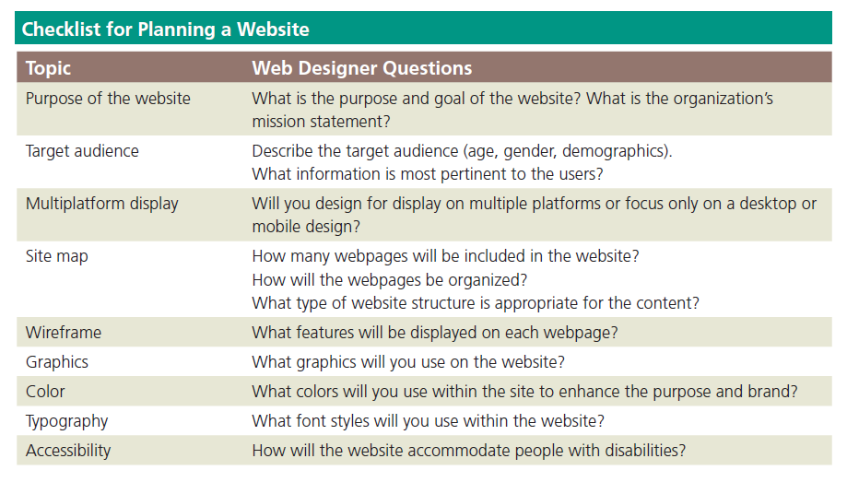
Planning Checklist
Notes:
This table has nine rows and two columns. The first cell in the first row first column is titled as Topic. Following information is given under this column.
Row 2: Purpose of the website
Row 3: Target audience
Row 4: Multiplatform display
Row 5: Site map
Row 6: Wireframe
Row 7: Graphics
Row 8: Color
Row 9: Typography
Row 10: Accessibility
The second column in the first row is titled as Web Designer Questions. Following information is given under this column.
Row 2: What is the purpose and goal of the website? What is the organization’s mission statement?
Row 3: Describe the target audience (age, gender, demographics). What information is the most pertinent to the users?
Row 4: Will you design for display on multiple platforms or focus only on a desktop or mobile design?
Row 5: How many webpages will be included in the website? How will the webpages be organized? What type of website structure is appropriate for the content?
Row 6: What features will be displayed on each webpage?
Row 7: What graphics will you use on the website?
Row 8: What colors will you use within the site to enhance the purpose and the brand?
Row 9: What font styles will you use within the website?
Row 10: How will the website accommodate people with disabilities?

Slide 26
Understanding the Basics of HTML
Webpages are created using Hypertext Markup Language (HTML), which is an authoring language used to create documents for the web
HTML consists of a set of special instructions called tags to define the structure and layout of content in a webpage
The HTML tags define or “mark up” the content on the webpage, due to which it is considered a markup language rather than a traditional programming language

Slide 27
HTML Elements and Attributes
A webpage is a text file that contains both content and HTML tags and is saved as an HTML document
An HTML element consists of everything from the start tag to the end tag
HTML elements can be enhanced by using attributes, which define additional characteristics, or properties, of an element

Slide 28
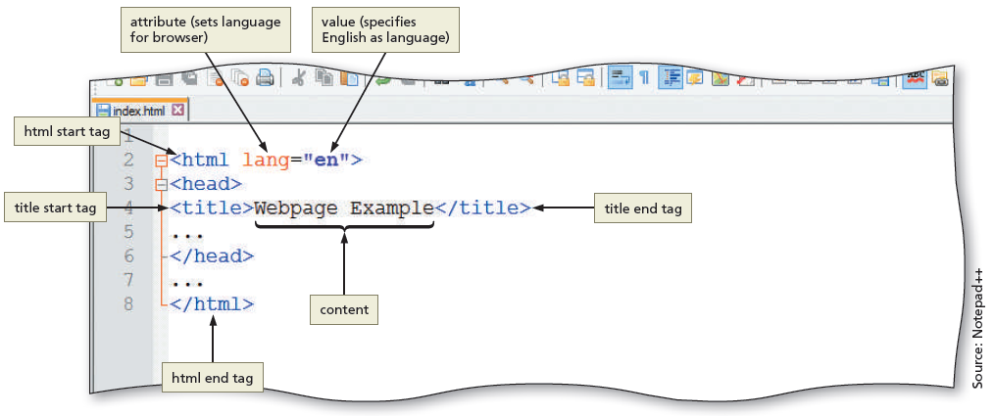
HTML Elements and Attributes
Notes:
The figures explains the anatomy of HTML elements in the text editor, Notepad++
The first line in the document reads <html lang = “en”>. The first rectangular box positioned to the left of the image is labeled “html start tag”. The arrow originates from the first rectangular box and points to “<html”. The second rectangular box positioned at the top of the image is labeled “attribute (sets language for browser)”. The arrow originates from the second rectangular box and points to “lang”. The third rectangular box positioned at the top of the image is labeled “value (specifies English as language)”. The arrow originates from the third rectangular box and points to “”en””.
The second line reads “<head>”.
The third line reads “<title>Webpage Example</title>”. The fourth rectangular box positioned to the left of the image is labeled “title start tag”. An arrow originates from the fourth rectangular box and points to “<title>”. The fifth rectangular box positioned below is labeled “content”. An arrow originates from the fifth rectangular box and points to “Webpage Example”. The sixth rectangular box positioned to the right of the image is labeled “title end tag”. An arrow originates from the sixth rectangular box and points to “</title>”.
The fifth line reads “</head>”.
The seventh line reads “</html>”. The seventh rectangular box positioned at the bottom of the image is labeled “html end tag”. An arrow originates from the seventh rectangular box and points to “</html>”.

Slide 29
HTML Elements and Attributes
HTML combines tags and descriptive attributes that define how a document should appear in a web browser
HTML elements include headings, paragraphs, hyperlinks, lists, and images
HTML elements have a start tag and an end tag and follow the same rules, or syntax

Slide 30
HTML Elements and Attributes
HTML elements are called paired tags and use the syntax <start tag> content </end tag>, which has the following meaning:
HTML elements begin with a start tag, or opening tag, such as <title>
HTML elements finish with an end tag, or closing tag, such as </title>
Content is inserted between the start and end tags

Slide 31
HTML Elements and Attributes
Some HTML elements are void of content. They are called empty, or void, tags
Examples of empty tags are <br> (or <br />) for a line break and <hr> (or <hr />) for a horizontal line, or rule

Slide 32
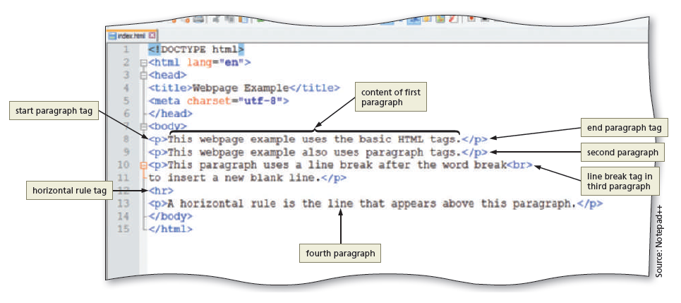
HTML Elements and Attributes
Notes:
The image explains HTML code and the content needed to create a webpage.
The eighth line of the code in the image reads “<p>This webpage example uses basic HTML tags.</p>”. The first rectangular box positioned to the left of the image is labeled “start paragraph tag”. An arrow originates from the first rectangular box and points to “<p>”. The second rectangular box positioned above “This webpage example uses the basic HTML tags.” is labeled “content of first paragraph”. An arrow originates from the second rectangular box and points to “This webpage example uses the basic HTML tags.” The third rectangular box positioned to the right of the image is labeled “end paragraph tag”. An arrow originates from the third rectangular box and points to “</p>”.
The ninth line of the code in the image reads “<p>This webpage example also uses paragraph tags.</p>. The fourth rectangular box positioned to the right of the image is labeled “second paragraph”. An arrow originating from the fourth rectangular points to “</p>”.
The tenth line of the code in the image reads “<p>This paragraph uses a line break after the word dreak”<br>”. The fifth rectangular box positioned to the right of the image is labeled “line break tag in third paragraph”. An arrow originates from the fifth rectangular box and points to “<br>”.
The twelfth line of code in the image reads “<hr>”. The sixth rectangular box positioned to the left of the image is labeled “horizontal rule tag”. An arrow originates from the sixth rectangular box and points to “<hr>”.
The thirteenth line of code in the images reads “<p>A horizontal rule is the line that appears above this paragraph.<p>”. The seventh rectangular box positioned at the bottom of the image is labeled “fourth paragraph”. An arrow originates from the seventh rectangular box and points to “line”.

Slide 33
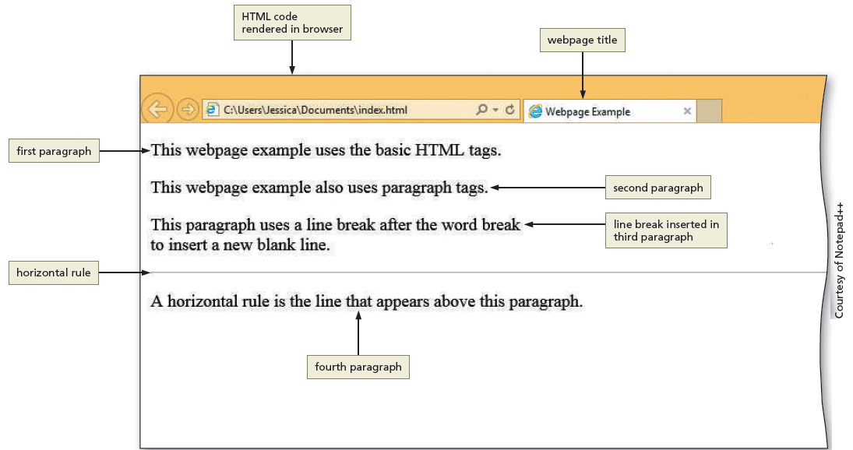
HTML Elements and Attributes
Notes:
This image explains output of the HTML code in the previous image.
The first line reads “This webpage example uses the basic HTML tags.” The first rectangular box positioned to the left of the image is labeled “first paragraph”. An arrow originates from the first rectangular box and points to “This webpage example uses the basic HTML tags.”
The second line reads “This webpage example also uses paragraph tags.” The second rectangular box positioned to the right of the image is labeled “second paragraph”. An arrow originates from the second rectangular box and points to “This webpage example also uses paragraph tags.”
The third line reads “This paragraph uses a line break after the word break”. The third rectangular box positioned to the right of the image is labeled “line break inserted in third paragraph”. An arrow originates from the third rectangular box and points to “This paragraph uses a line break after the word break”.
The fourth line indicates a horizontal line across the page. The fourth rectangular box positioned to the left of the image is labeled “horizontal rule”. An arrow originates from the fourth rectangular box and points to the horizontal line.
The fifth line reads “The horizontal rule is the line that appears above this paragraph”. The fifth rectangular box positioned to the bottom of the image is labeled “fourth paragraph”. An arrow originates from the fifth rectangular box and points to “The horizontal rule is the line that appears above this paragraph”.

Slide 34

Exercise
Open Notepad and create a web page file using example on slide 32.
Save the file as index.html using “All Files” type
Open the index.html file in a browser and see how the browser interpreted your HTML code.

Slide 35
Technologies Related to HTML
XML — The W3C introduced XML (Extensible Markup Language) in 1998 to exchange and transport data
XHTML — (Extensible Hypertext Markup language) is a rewritten version of HTML using XML and was developed in 2000 and is accepted on mobile device platforms
DHTML — DHTML (Dynamic Hypertext Markup Language) is a term that refers to a combination of web technologies

Slide 36
HTML5
It is the most recent version of HTML
It introduces several new elements such as header, nav, main, and footer to better define the areas of a webpage
They are known as semantic HTML elements because they provide meaning about the content of the tags
It provides a more flexible approach to web development

Slide 37
Understanding the Role of Other Web Programming Languages
JavaScript — It is a popular client-side scripting language used to create interactivity within a web browser
The web pages that contain JavaScript are named with an .htm or .html extension
jQuery — It is a library of JavaScript programs designed for easy integration onto a webpage
It makes it easy for web developers to add JavaScript to a webpage

Slide 38
Understanding the Role of Other Web Programming Languages
PHP (Hypertext Preprocessor) — It is an open-source server-side scripting language used for common tasks such as writing to or querying a database located on a central server
Pages that contain PHP scripts must have file names that end with the file extension .php
ASP (Active Server Pages) — is a server-side scripting technology
Pages that contain ASP scripts must have file names that end with the file extension .asp

Slide 39
Using Web Authoring Tools
Webpages can be created using HTML with a simple text editor, such as Notepad, Notepad++, Sublime, Programmer’s Notepad, TextEdit, and TextWrangler
A text editor is a program that allows one to enter, change, save, and print text, which includes HTML tags
An HTML editor is a program that provides basic text-editing functions, and advanced features such as color-coding for various HTML tags, menus to insert HTML tags, and a spelling checker
HTML is platform independent

Slide 40
Text Editors
Notepad++ is a free, open-source text editor. It is used to create files in several markup, scripting, and programming languages, including HTML, CSS, JavaScript, PHP, Java, C#, and Visual Basic
Programmer’s Notepad is a free, open-source text editor used to create webpages, and files in several markup, scripting, and programming languages as well
Sublime is a cross-platform text editor
TextWrangler is a free, open-source text editor. It is used to create files in many formats, including HTML and CSS

Slide 41
WYSIWYG Editors
WYSIWYG stands for What You See Is What You Get
These editors provide a graphical user interface to design a webpage
It allows to drag HTML elements onto the page while the editor writes the code
Adobe Dreamweaver is a popular WYSIWYG editor
Microsoft Expression Web 4 is a WYSIWYG webpage editor from Microsoft
This program not teach WYSIWYG editors. Why?

Slide 42
Web Design with HTML5 & CSS3
Building a Webpage Template with HTML5

Slide 43
Designing a Website
Designing a website includes the following:
Planning
Articulating the website’s purpose
Identifying the target audience
Creating a site map and wireframe
Selecting graphics and colors to use in the site
Determining whether to design for an optimal viewing experience across a range of devices

Slide 44
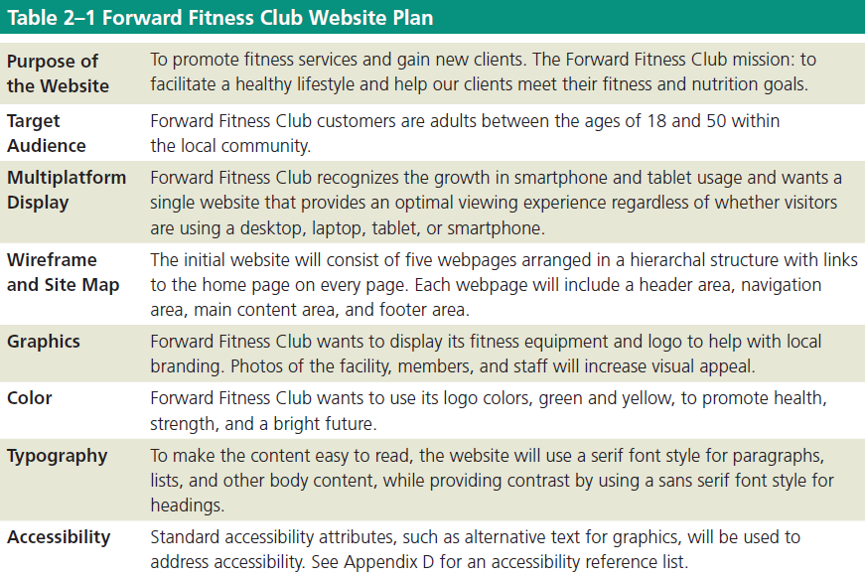
Designing a Website (continued)

Slide 45
Site Map
Site map indicates how the pages in a website relate to each other
For example, the webpages of the Forward Fitness Club website will include the following content:
Home page: Introduces the fitness center and its mission statement
About Us page: Showcases the facility’s equipment and services
Classes page: Includes a schedule of available group training and fitness classes
Nutrition page: Provides nutrition tips and simple meal plans
Contact Us page: Provides a phone number, email address, physical address, and form for potential clients to request additional information about the fitness center’s services

Slide 46
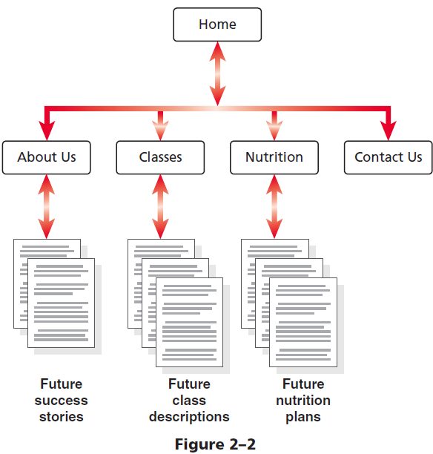
Site Map (continued 2)

Slide 47
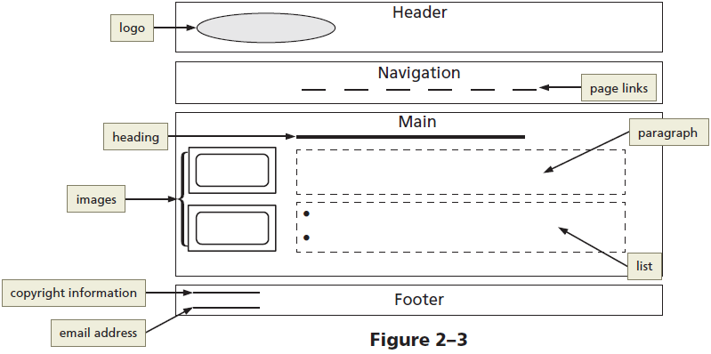
Wireframe
Wireframe depicts the layout of a webpage, including its major content areas

Slide 48
File Management
Websites use several types of files, including HTML files, image files, media such as audio and video files, and CSS files
Each site must follow a systematic method to organize its files
The main folder, also called the root folder, contains all files and other folders for the website

Slide 49
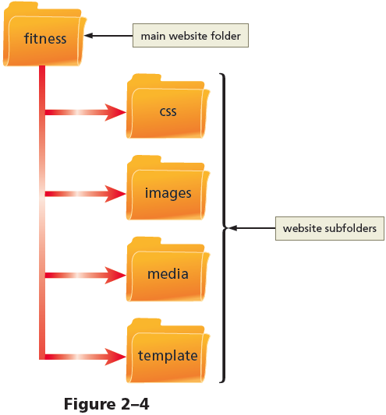
File Management (continued)

Slide 50
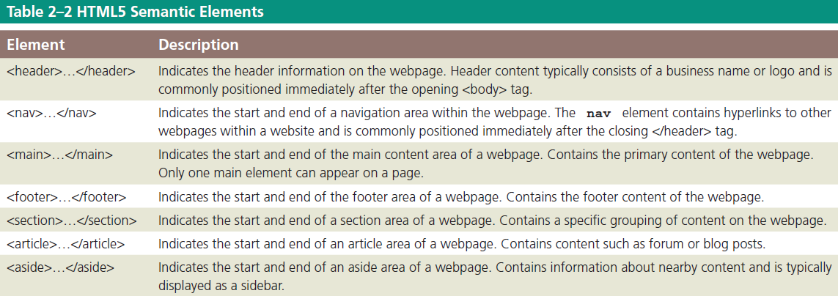
Using HTML5 Semantic Elements

Slide 51
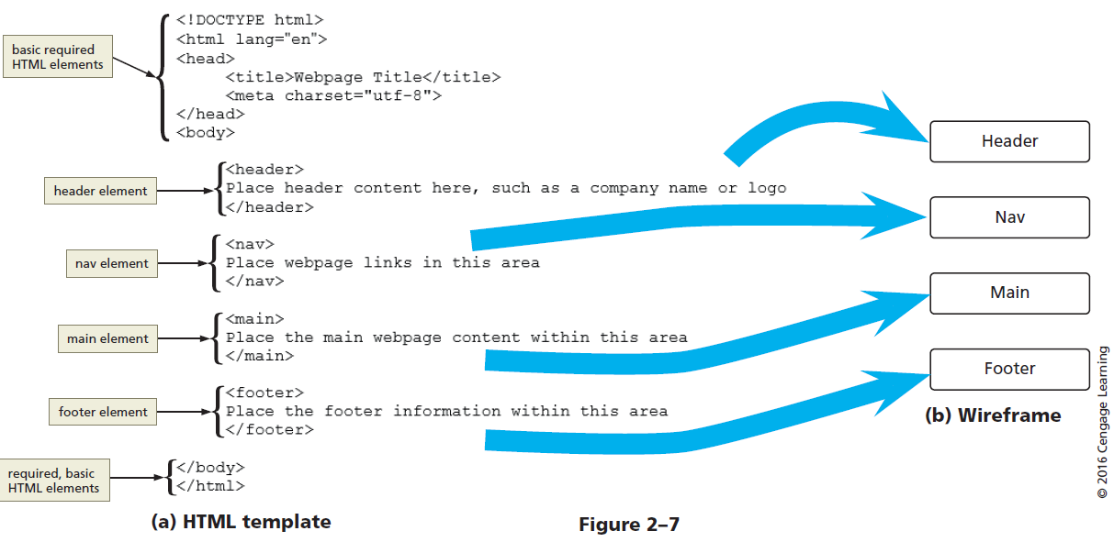
Using HTML5 Semantic Elements (continued 1)

Slide 52
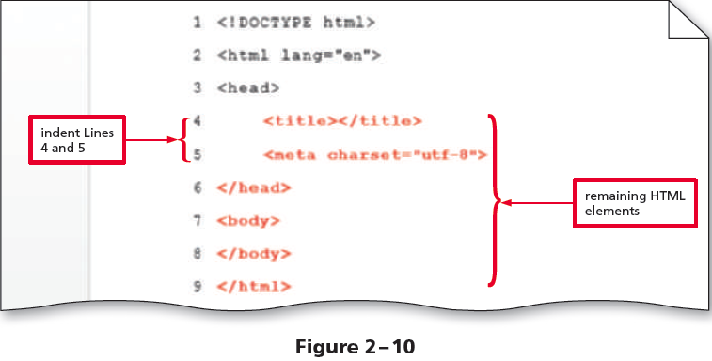
Create a Webpage Template Document

Slide 53
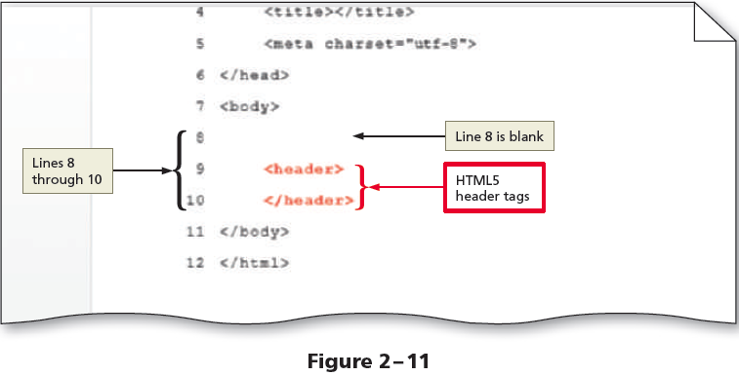
Add HTML5 Semantic Elements to the Webpage Template

Slide 54
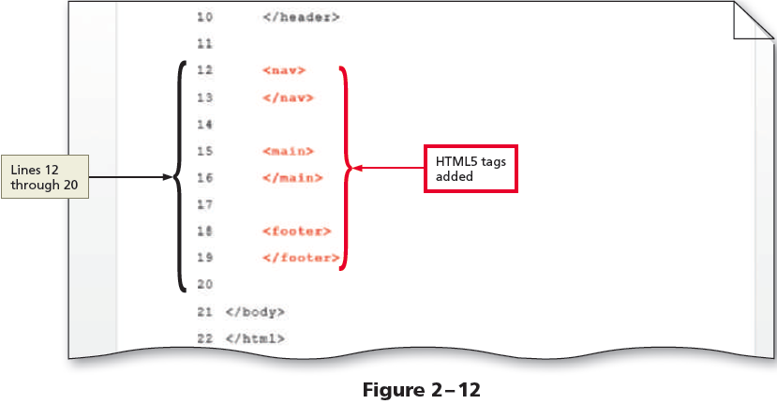
Add More Semantic Elements to the Webpage Template
Save the changes

Slide 55
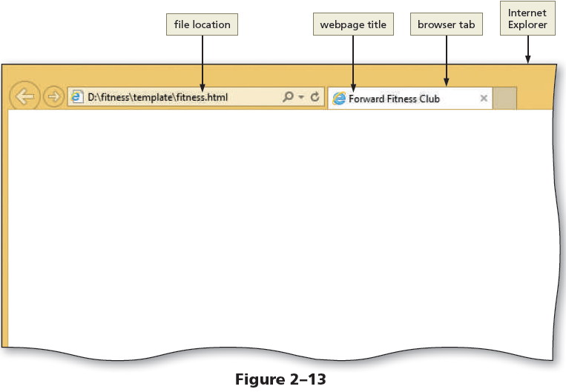
Add a Title to a Webpage Template
The following steps add a webpage title to a template:
Place an insertion point after the beginning <title> tag and type Forward Fitness Club to add a webpage title
Save the changes and then view the page in a browser to display the webpage title

Slide 56
Comments
Comments can provide additional information about the areas within the webpage
Add a comment before a tag using the following tag:
<! - - Place your comment here - - >
Word wrap causes text lines to break at the right edge of the window and appear on a new line
Why are comments important?

Slide 57
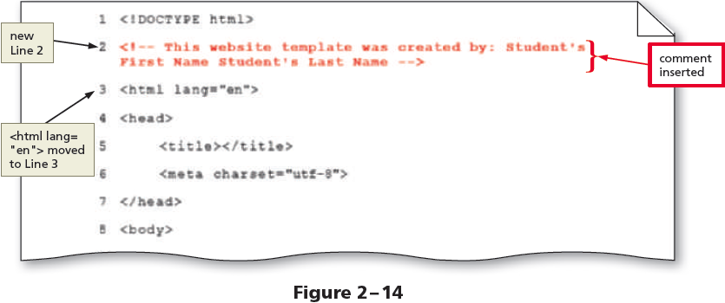
Add Comments to a Webpage Template

Slide 58
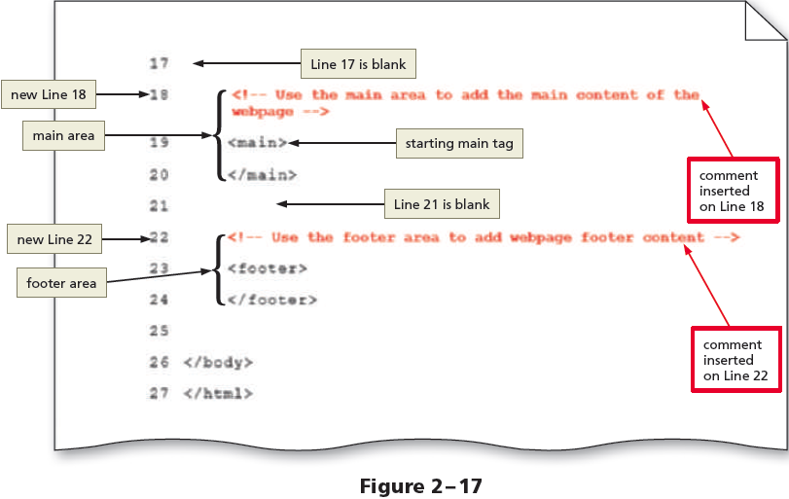
Add More Comments to the Webpage Template
Save the changes

Slide 59
Webpage Content
Static content can be added to a webpage that will appear on every webpage, such as the business name or logo, the webpage links, and the footer information
Following is an example of content added between header tags:
<header>Forward Fitness Club</header>

Slide 60
Using Symbol Entities
Symbols can be added to an HTML webpage by typing its HTML entity name or entity number
Inserting an HTML character entity in the code displays a reserved HTML character on the webpage
Entity name is an abbreviated name
Entity number is a combination of the pound sign (#) and a numeric code

Slide 61
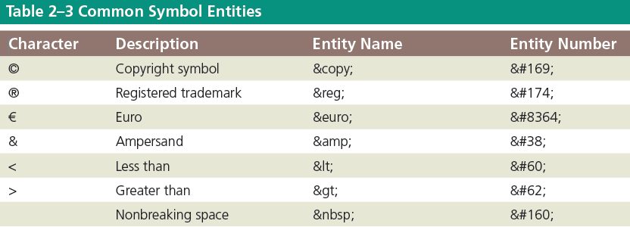
Using Symbol Entities (continued)

Slide 62
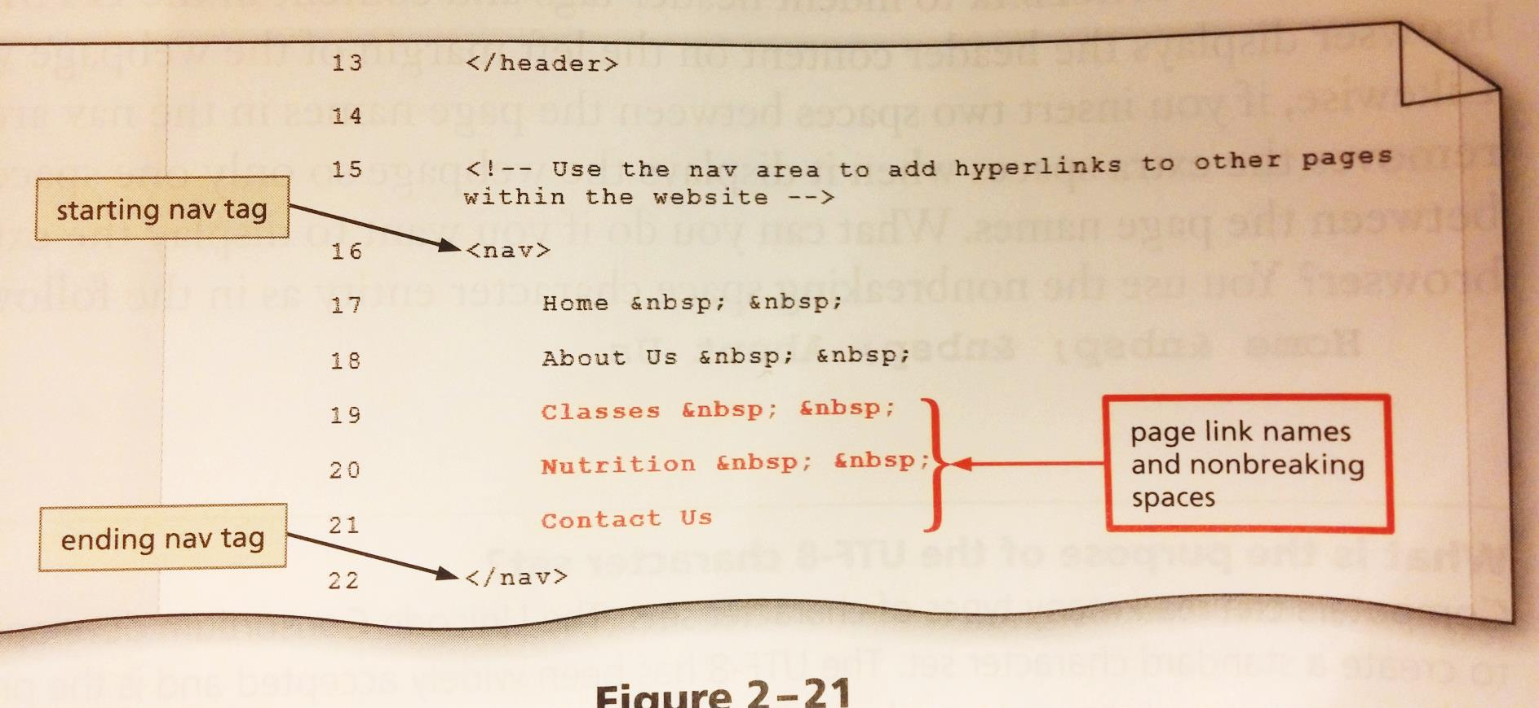
Add Text and Nonbreaking Spaces to the Nav Section
Save the changes

Slide 63
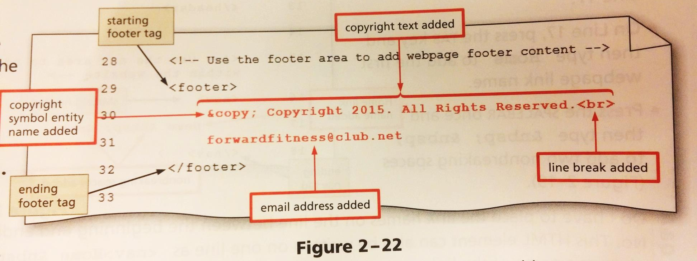
Add Content and a Symbol to the Footer Section
Save the changes

Slide 64
Validating HTML Documents
After the creation of an HTML file, the document can be validated to verify the validity of the HTML code
A validator checks for errors, indicates where they are located, and suggests corrections
If the validator detects an error in an HTML code, it displays a warning
You can use http://validator.w3.org to validate your HTML code.

Slide 65
Create a Home Page Using Our Webpage Template
This saves considerable time since we won’t have to re-create the static HTML elements on each page.
Homepages typically are named “index.html”.
We must be sure to save our template file (“fitness.html”) under the new name FIRST before making changes.
Clicking File then Save As will allow you to create a new file from the same HTML data we have already created in our text editor.
Note: Go UP one folder level so “index.html” is in the main “fitness” folder (not in the “template” folder).

Slide 66
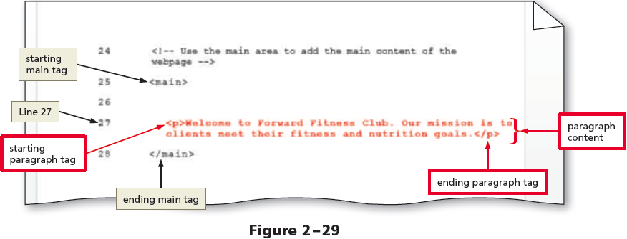
Creating a Home Page Using a Webpage Template
<p>Welcome to Forward Fitness Club. Our mission is to help our clients meet their fitness and nutrition goals. </p>

Slide 67
Exercise
Choose a topic for a new web site (fitness club, charity organization, Hunter Business School etc.)
Document a website plan (see slide 46 for details)
Create a site map
Create a wireframe using the tool of choice (MS Office, pencil and paper or third-party tools, such as mockflow.com)
Create 2-3 sample web pages
Validate your HTML code

